Slide 1
Inferential Statistics
&
Applied Probability
Course Code: DS221
Credits: 3
Instructor: Muhammad Sajid Ali

Slide 2
Warm Up Question?
What do you ask for usually about the stats of an exam with numerical scores?

Slide 3
Summarizing 1D Continuous Data
For a data set {x} or annotated as {x_{i} }, we summarize with:
Location parameters
  Mean (average)
  Median (middle)
  Mode (most frequent value)
  Which summarize the central point of a dataset.

Slide 4
Summarizing 1D Continuous Data
For a data set {x} or annotated as {x_{i} }, we summarize with:
Scale parameters
  Range
  Variance
  Standard deviation
  Interquartile range
  Which describe how much the data varies or spreads out

Slide 5
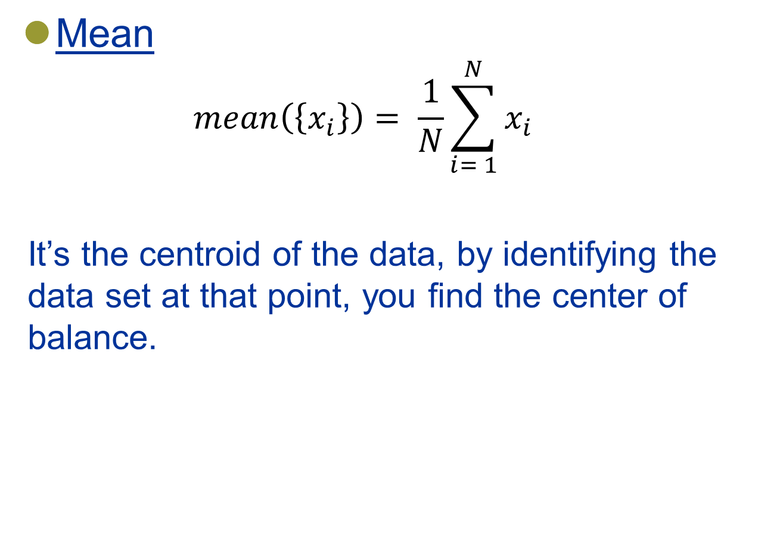
Summarizing 1D Continuous Data

Slide 6
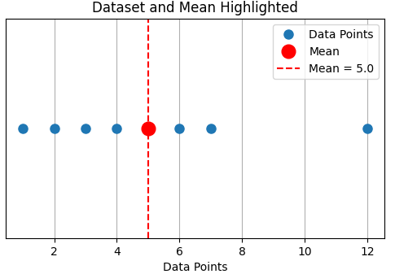
Summarizing 1D Continuous Data
Mean
  Consider the dataset = {1, 2, 3, 4, 5, 6, 7, 12}

Slide 7
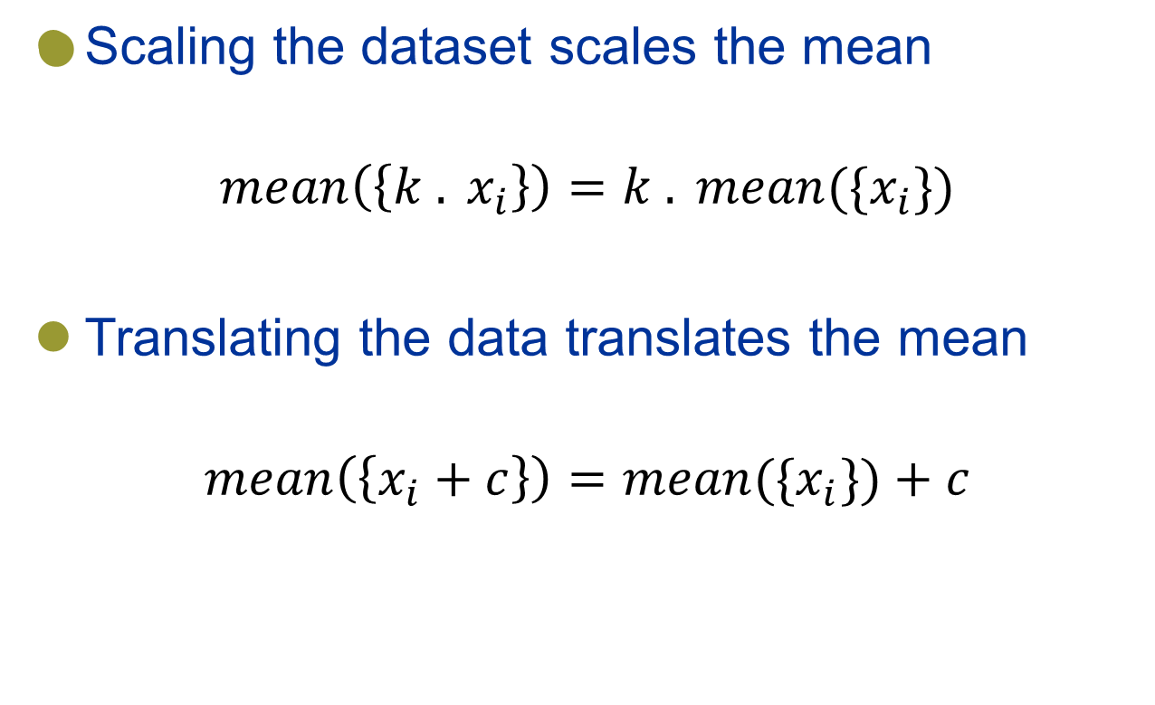
Properties of the Mean

Slide 8
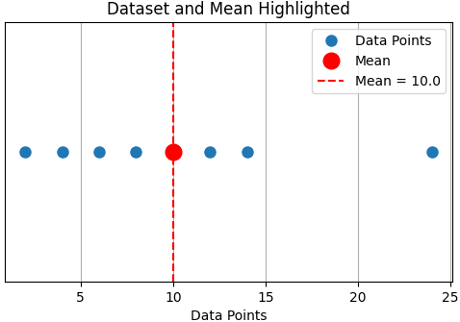
Properties of the Mean
Scaling the dataset scales the mean
  Dataset = {1, 2, 3, 4, 5, 6, 7, 12}
  Scaled by 2 = {2, 4, 6, 8, 10, 12, 14, 24}

Slide 9
Properties of the Mean – Scaling

Slide 10
Properties of the Mean
Scaling the dataset scales the mean
  Scaling changes the position of the points from the mean because the mean itself scales.
  Relative distances between the points and from the mean remain proportional, meaning the overall shape of the data is preserved, but it is stretched or compressed.
  The spread of the data changes (the data gets compressed or stretched).

Slide 11
Properties of the Mean
Scaling the dataset scales the mean
  Relative distances between the points and from the mean remain proportional, means …
Data-points before scale | 1 | 2 | 3 | 4 | 5 | 6 | 7 | 12
Diff from mean (µ = 5) | -4 | -3 | -2 | -1 | 0 | 1 | 2 | 7
Data-points After scale by 2 | 2 | 4 | 6 | 8 | 10 | 12 | 14 | 24
Diff from mean (µ = 10) | -8 | -6 | -4 | -2 | 0 | 2 | 4 | 14

Slide 12
Summarizing 1D Continuous Data
Mean
  Consider the dataset = {1, 2, 3, 4, 5, 6, 7, 12}

Slide 13
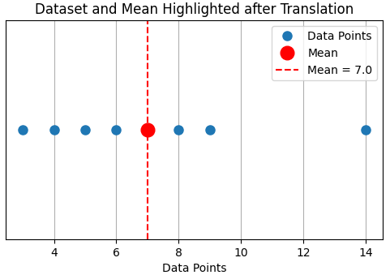
Properties of the Mean
Translating the data translates the mean
  Dataset = {1, 2, 3, 4, 5, 6, 7, 12}
  Translate + 2 = {2, 4, 5, 6, 7, 8, 9, 14}

Slide 14
Properties of the Mean
Translating the data translates the mean
  Translation changes the position of the points from the mean because the mean itself translates.
  The spread of the data does not change.

Slide 15
Properties of the Mean
Important Question
Why there is a need to scale and translate the dataset?

Slide 16
Properties of the Mean
Scaling data ensures that different features are on a similar range or scale. This is important for several reasons:
  Machine learning algorithms sensitivity
    Features with larger values will dominate features with small values (e.g. age and income)
  Normalization for specific contexts:
    Scaling standardizes data to a common scale
    Crucial for accurate interpretation and combining data from diverse sources.

Slide 17
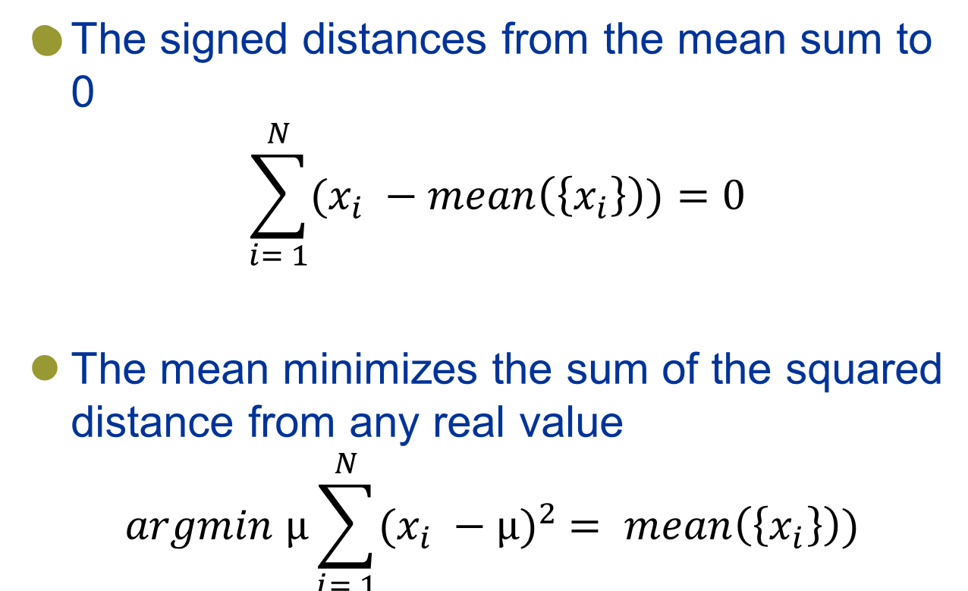
Less Obvious properties of the Mean

Slide 18
Less Obvious properties of the Mean
The signed distances from the mean sum to 0
The sum of all data points difference from mean is 0
Data-points | 1 | 2 | 3 | 4 | 5 | 6 | 7 | 12
Diff from mean (µ = 5) | -4 | -3 | -2 | -1 | 0 | 1 | 2 | 7

Slide 19
Less Obvious properties of the Mean
The mean minimizes the sum of the squared distances from any real value
The mean is the point that makes the total squared deviations from the data as small as possible.
Data-points | 1 | 2 | 3 | 4 | 5 | 6 | 7 | 12
Diff from mean (µ = 5) | -4 | -3 | -2 | -1 | 0 | 1 | 2 | 7
Square the diff | 16 | 9 | 4 | 1 | 0 | 1 | 4 | 49
 | Total is = 84
Data-points | 1 | 2 | 3 | 4 | 5 | 6 | 7 | 12
Diff from any other real value (6) | -5 | -4 | -3 | -2 | -1 | 0 | 1 | 6
Square the diff | 25 | 16 | 9 | 4 | 1 | 0 | 1 | 36
 | Total is = 92

Slide 20
Less Obvious properties of the Mean
Important Question
Why there is a need to square the distances from mean?

Slide 21
Why there is a need to square the distances from mean?
  Emphasizes Larger Deviations: Squaring highlights larger differences more significantly.
  Non-Negative Values: Ensures all deviations contribute positively.
  Mathematical Convenience: Simplifies calculations in regression and optimization.
  Measures Variability: Used in variance and standard deviation to assess data spread.

Slide 22
Question
What is the answer for:
mean( { mean( {x_{i}} ) } ) ?
mean({x_{i}})
Unsure
0

Slide 23
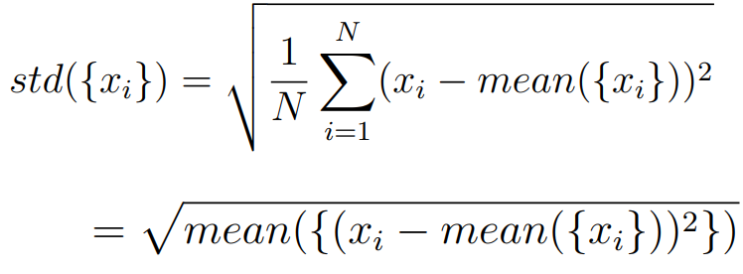
Standard Deviation
The standard deviation tells, how much data is spread out with respect to the mean

Slide 24
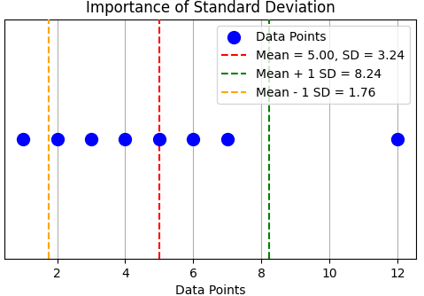
Standard Deviation
Consider the same dataset we used previously

Slide 25
Question
Can a standard deviation of a dataset be -1
Yes
No

Slide 26

Properties of the Standard Deviation
Scaling data scales the standard deviation
Translating the data does NOT change the standard deviation

Slide 27
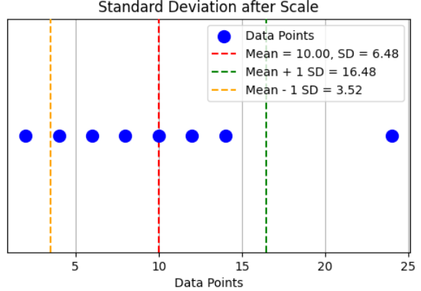
Properties of the Standard Deviation
Scaling the dataset scales the standard deviation
  Dataset = {1, 2, 3, 4, 5, 6, 7, 12}
  Scaled by 2 = {2, 4, 6, 8, 10, 12, 14, 24}

Slide 28
Properties of the Standard Deviation

Slide 29
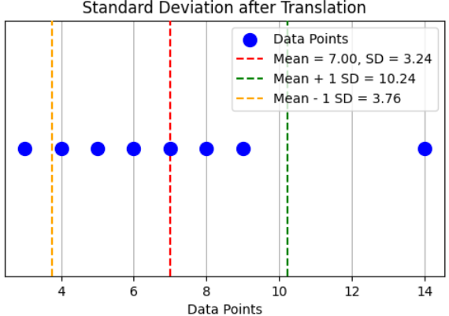
Properties of the Standard Deviation
Translating the data does NOT change the standard deviation
  Dataset = {1, 2, 3, 4, 5, 6, 7, 12}
  Translate + 2 = {3, 4, 5, 6, 7, 8, 9, 14}

Slide 30
Properties of the Standard Deviation

Slide 31
Question
What is the value of
std({ mean({x_{i}}) }) ?
0
1
Unsure

Slide 32
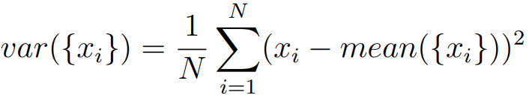
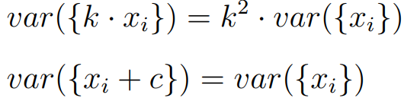
Variance (σ²)
Variance = (standard deviation)²
Scaling and translating is similar to standard deviation

Slide 33
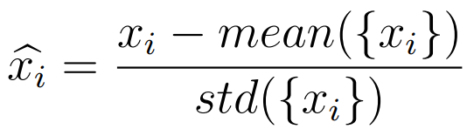

Standard Coordinates / Normalized Data
The mean tells where the data set is and the standard deviation tells how spread out it is.
If we are interested only in comparing the shape of the datasets, we could define
We say is in standard coordinates

Slide 34
Question – Mean of Standard Coordinates?
Mean of is
1
0
Unsure

Slide 35
Question – STD Dev of Standard Coordinates?
Std.Dev of is
1
0
Unsure

Slide 36
Standard Coordinates/normalized data to μ=0, σ=1, σ²=1
Data in standard coordinates always has
Mean = 0
Standard deviation = 1
Variance = 1
Such data is unit-less, plots based on this sometimes are more comparable

Slide 37
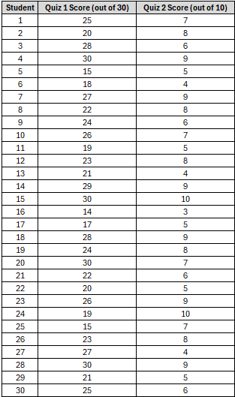
Standard Coordinates / Normalized Data
Consider the students score in two quizzes.
Quiz1
mean = 23.5, STD = 4.17
Quiz2
mean = 7, STD = 1.73
Using Means: You might think the score of 28 is better simply because it’s higher.

Slide 38
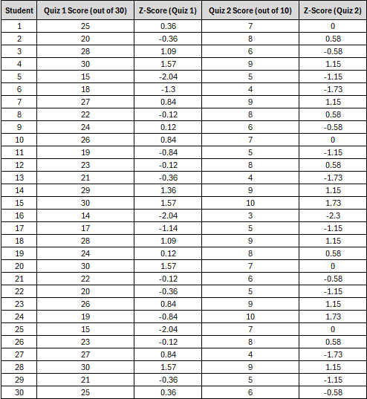
Standard Coordinates / Normalized Data
Consider the students Z score in two quizzes.
Quiz1
mean = 23.5, STD = 4.17
Quiz2
mean = 7, STD = 1.73

Slide 39
Standard Coordinates / Normalized Data
A score of 28 in Quiz 1 (Z = 1.25)
A score of 9 in Quiz 2 (Z = 1.50)
Using Z-scores: The Z-scores indicate that the performance relative to peers is better in Quiz 2, showing the importance of context in evaluation.

